Slide 1

Midland County Hospital District
2022 Redistricting
Initial
Assessment
BICKERSTAFF HEATH DELGADO ACOSTA LLP
3711 S. MoPac Expressway
Building One, Suite 300
Austin, Texas 78746
(512) 472-8021
www.bickerstaff.com
©2022
Notes:
Introduction – Attorney and Firm
The purpose of this presentation is to:
Review the population of the director districts based on the recently released 2020 Census
Review theDistrict’s obligation to re-draw the boundaries of the seven director districts so that the population in each of the districts is balanced
Explain the legal requirements that come into play in that process
Explain how the District’s process will meet these legal requirements

Slide 2
REDISTRICTING
Applicable Law
Three Principles, plus
“One person – one vote” (equal population)
Voting Rights Act § 2 (nondiscrimination)
Shaw v. Reno (limits use of race)
Plus, as diagnostic tool: Voting Rights Act § 5 (retrogression)
©2022

Slide 3
Redistricting
One Person - One Vote
U.S. Constitution – single-member districts must have approximately equal populations
Rule of thumb: total deviation < 10%
  Compare most populous and least populous districts to “ideal”–sized district
  Add both departures from ideal together
©2022
Notes:
City single-member districts are legislative districts that are subject to the one-person one vote requirements of the fourteenth amendment of the U.S. Constitution.
As such, each councilmember district must have equal population.
The release of the census figures each decade triggers the City’s obligation to review the councilmember districts and rebalance them if necessary.

Slide 4
Example Deviation Calculation
©2022

Slide 5

Available Census Data
PL94-171 File
  “Census block” level
    Total population
    VAP (voting age population)
    Race
    Hispanic origin
©2022
Notes:
On August 12, 2021 the Federal Census Bureau released the 2020 census data for Texas. This data is referred to as the PL94-171 data or Public Law data.
It is derived from census forms which each of us filled out and filed with the agency last year.
The Public Law data includes certain demographic information and also includes voting age and total population figures that are specific down to the block level here at the County.
The census data that has been released contains the compilation of this demographic information. There are a number of racial categories that a person could have chosen on the census form, (White, African American/Black, Asian, American Indian/Alaska Native, Native Hawaiian or Other Pacific Islander, some other race or multiple race. In addition to selecting one or more racial categories there was one ethnic category on the census that could be selected which is Hispanic.
Accordingly, the census data that has been compiled and released by the U.S. Census Bureau is broken down into 28 different possible permutations of race and ethnicity.

Slide 6
What Population Do You Use?
Total Population
To determine one person - one vote
VAP
(Voting Age Population)
To measure voting rights issues
©2022
Notes:
To determine whether the director districts are in balance, we will utilize total population figures provided in the census data. This is the information that has been utilized by every political subdivision in the United States in submissions to the United States Department of Justice which reviews our changes.
To the extent that the Dostroct will need to analyze voting rights issues we will utilize the voting age population figures in the census and may also rely on Spanish Surnamed Registered Voter information and/or turnout information at the county election precinct level and other indicators of potential voting strength within the District.

Slide 7
Section 2 of the Voting Rights Act
No discrimination on basis of race or language minority status
Generally, avoid cracking or packing
Cracking or fracturing is dividing minority voters to fragment their voting power.
Packing is concentrating minority voters when dividing them would permit the group to elect their candidates of choice in more than one district
Other practices can also violate Section 2
©2022
Notes:
Discuss

Slide 8
14th Amendment
(Shaw v. Reno)
Limits race-based decision making, including redistricting
Was race the predominant consideration in drawing a redistricting plan?
If so, is the plan a narrowly tailored means of addressing a compelling governmental interest?
©2022
Notes:
Once we determine our Section 5 and Section 2 issues, then we must examine the countervailing principle which is the Shaw v. Reno line of cases.

Slide 9
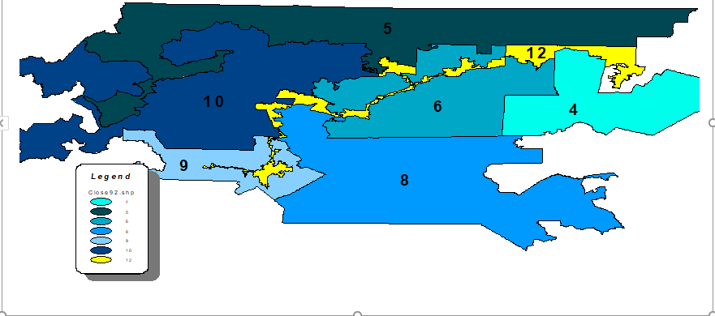
CLOSE UP OF NORTH CAROLINA 1992 PLAN A
©2022
Notes:
Once we determine our Section 5 and Section 2 issues, then we must examine the countervailing principle which is the Shaw v. Reno line of cases.

Slide 10
Bush v. Vera
After
Before
©2022
Notes:
Describe example where court declared plan (top) as violation of principles in Shaw v. Reno and then adopted more compact version (bottom)

Slide 11
Redistricting Standards under
Shaw-Reno Line of Cases
Usually, race may not be the predominant factor to the subordination of traditional districting principles
But it is OK to be aware of race and to consider race to satisfy Section 2 and Section 5
To “narrowly tailor,” use race no more than necessary
Bizarrely-shaped districts not unconstitutional per se
  Bizarre shape may be evidence that race predominated
©2022
Notes:
Lessons that we need to take from Shaw V. Reno line of cases and which we can build into our criteria so that we do not run afoul of this principle as we rebalance the director districts.

Slide 12
Section 5 of the Voting Rights Act
Preclearance no longer required (Shelby County v. Holder (2013))
Section 5 standard is “retrogression”
  Are minorities worse off under the new system?
  No discriminatory purpose or effect
Still a useful diagnostic tool to identify potential Section 2 issues
©2022
Notes:
.

Slide 13
Benchmark
The benchmark is the standard against which retrogression is measured.
The benchmark is 2020 Census data superimposed on the last legally enforceable plan (typically, 2011 lines).
©2022
Notes:
To determine if the proposed plan is lawful, DOJ will measure it against the benchmark plan – which is simply the new 2020 census data superimposed on the existing (last precleared) director district boundaries.
Essentially, DOJ will be looking at the strength of minority districts before and after any redistricting plan to measure whether the districts are draw in such a way as to reduce minority voting strength.

Slide 14
Adopt Criteria
Identifiable boundaries
Maintaining communities of interest & neighborhoods
Using whole voting precincts, if possible
Basing plan on existing districts
Adopting districts of relatively equal size
Drawing districts that are compact and contiguous
Keeping existing incumbents in their districts
Narrowly tailoring plan to comply with the VRA
©2022
Notes:
Explain how we have proposed criteria for consideration by the Board of Directors. Here are notes on various elements:
Compactness has geographic and functional dimension. A district, even when not geographically compact, can be functionally compact depending on such matters as:
Voting patterns
Income
Education
Home ownership
The availability of transportation and communication
The existence of common social and economic interest
The ability of the constituents to relocate to each other
Examples of easily identifiable geographic boundaries
Highways
Major roads
Rivers
Creeks
Bridges
Golf courses
Stadiums
Parks
Cemeteries
College campuses
Hospitals
Race tracks
Other public buildings & landmarks
Whole Voting Precinct Notes
Prevent and eliminate voter confusion by taking into consideration the boundaries created for other public purposes.
Draw based on existing voting precincts as established by the county.
Notes on keeping incumbents in district
Preserve the will of the voters
Provide consistency in the incumbent-constituent relationship.

Slide 15
Steps To Balancing Conflicting
Legal Obligations In Redistricting
Plan ahead
Build a record
Be Aware
Of legal obligations and responsibilities
Adopt
Criteria that reflect traditional redistricting principles, including consideration of race to the extent required to meet obligations under the Voting Rights Act
Pay Attention
To the criteria when drawing the plan. Consider and evaluate each plan presented (whether by district’s hired consultant or by general public) in light of the adopted criteria.
©2022

Slide 16
Steps To Balancing Conflicting
Legal Obligations In Redistricting
Analyze the final plan in terms of how well it conforms to the adopted criteria
Make sure the analysis is considered by the Board of Directors before plan adoption
Avoid districts that are not compact
©2022

Slide 17

Plan Development
(Subject to Charter Amendment)
Initial Assessment
Adopt plan criteria, guidelines
Develop illustrative plan(s)
Public comment / hearing
Analyze comments
Adopt final plan
Implementation
©2022

Slide 18
Midland County Hospital District
Proposed Redistricting Timeline
2/7/22 – Present Initial Assessment
TBD – First Drawing Workshop
TBD – Second Drawing Workshop
TBD – Public Hearing
TBD – Adoption
  For November 2022 election, adopt by July 22, 2022 (candidate sign up begins next day)

Slide 19

MIDLAND COUNTY HOSPITAL DISTRICT
2011 Benchmark with 2020 Census Data
©2022
Notes:
Discuss the data.

Slide 20
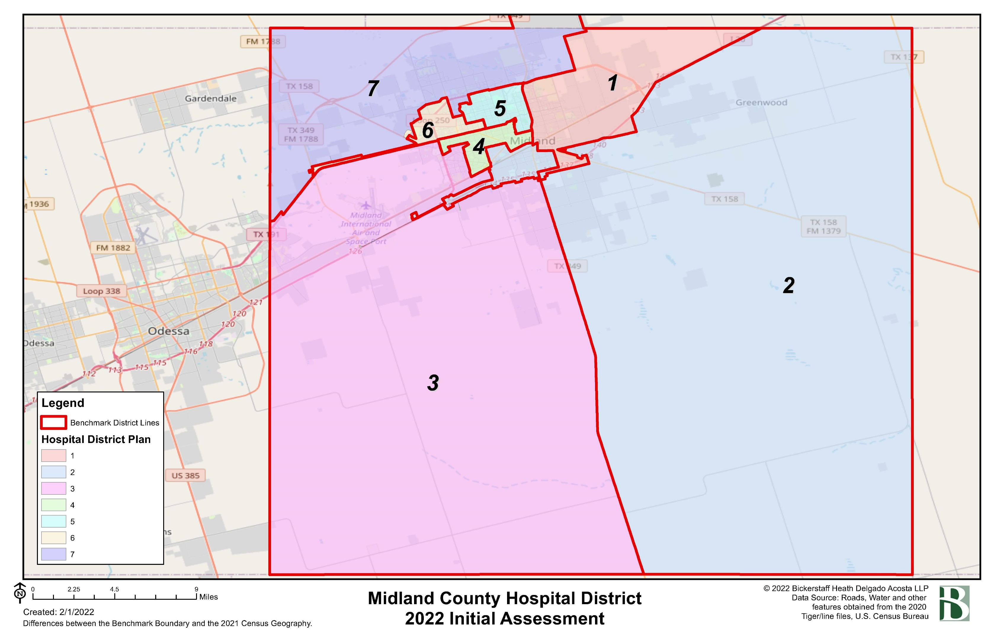
Current Districts

Slide 21
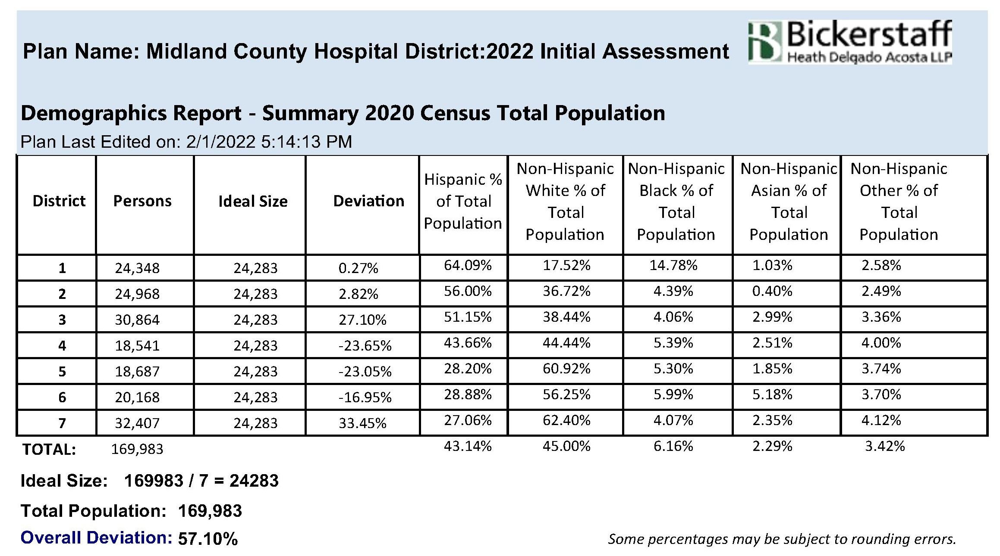
Midland County Hospital District
Overall Deviation For Current Director Districts
Using 2020 Census Data

Slide 22
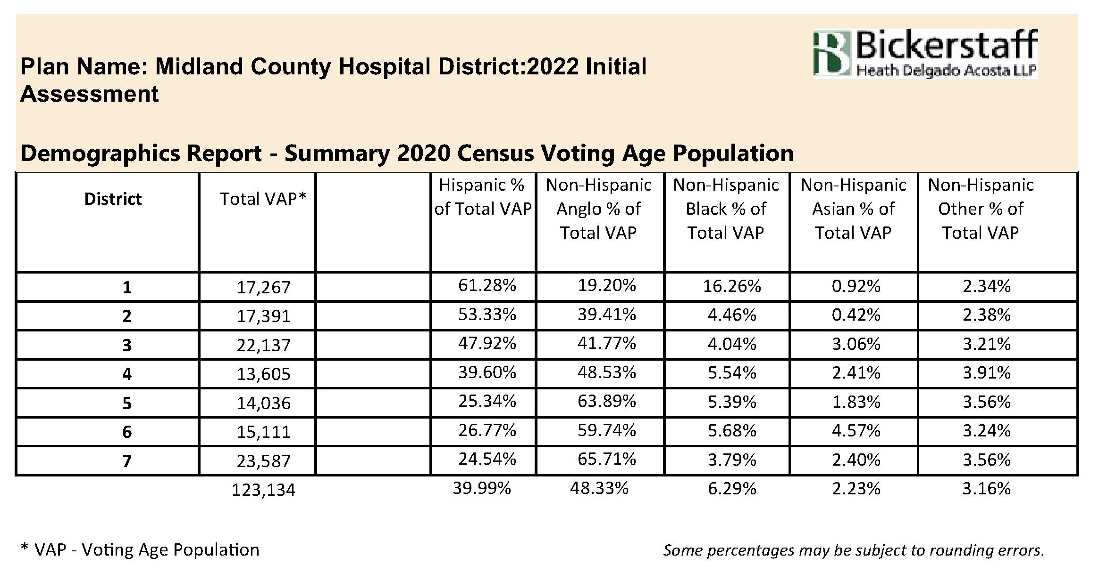
Midland County Hospital District
Overall Deviation For Current Director Districts
Using 2020 Census Data

Slide 23
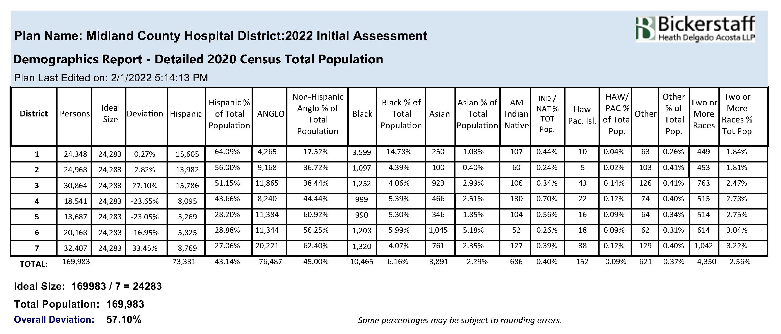
Midland County Hospital District
Overall Deviation For Current Director Districts
Using 2020 Census Data

Slide 24
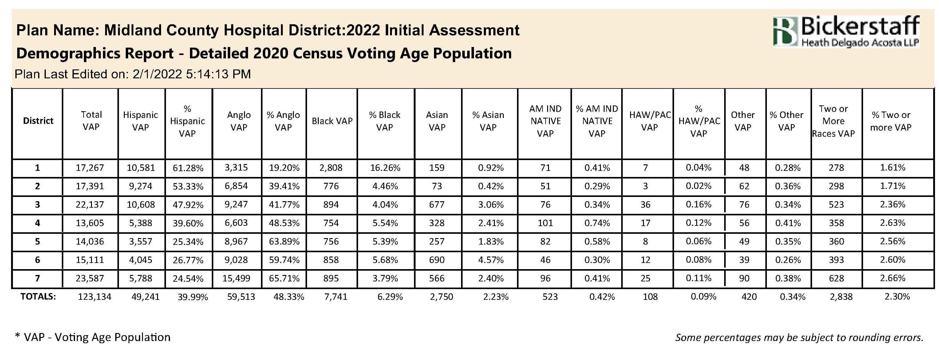
Midland County Hospital District
Overall Deviation For Current Director Districts
Using 2020 Census Data

Slide 25
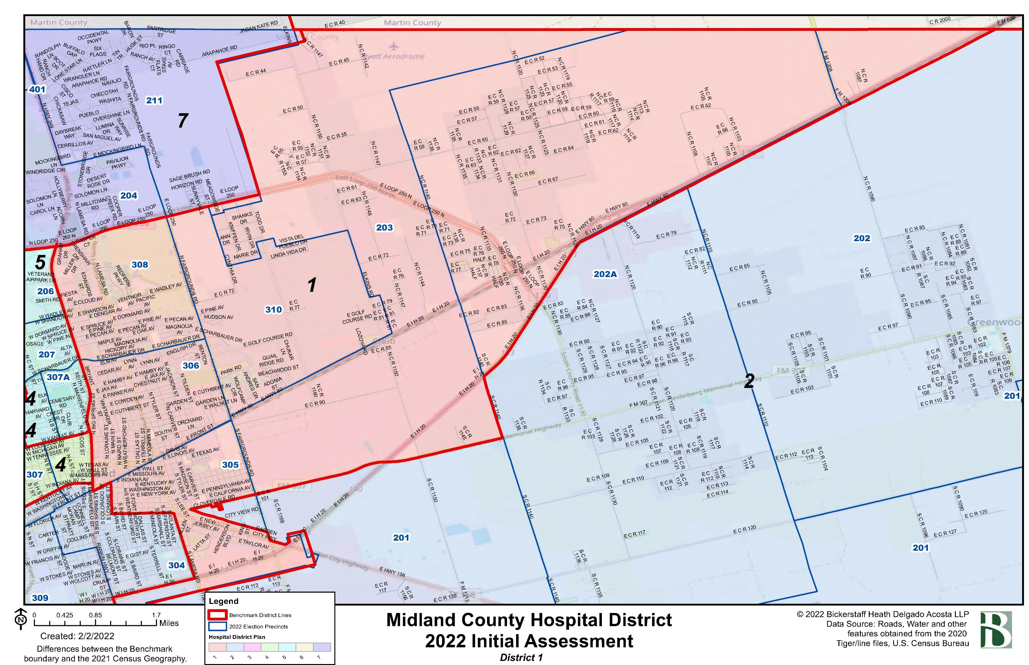
Individual District Maps

Slide 26
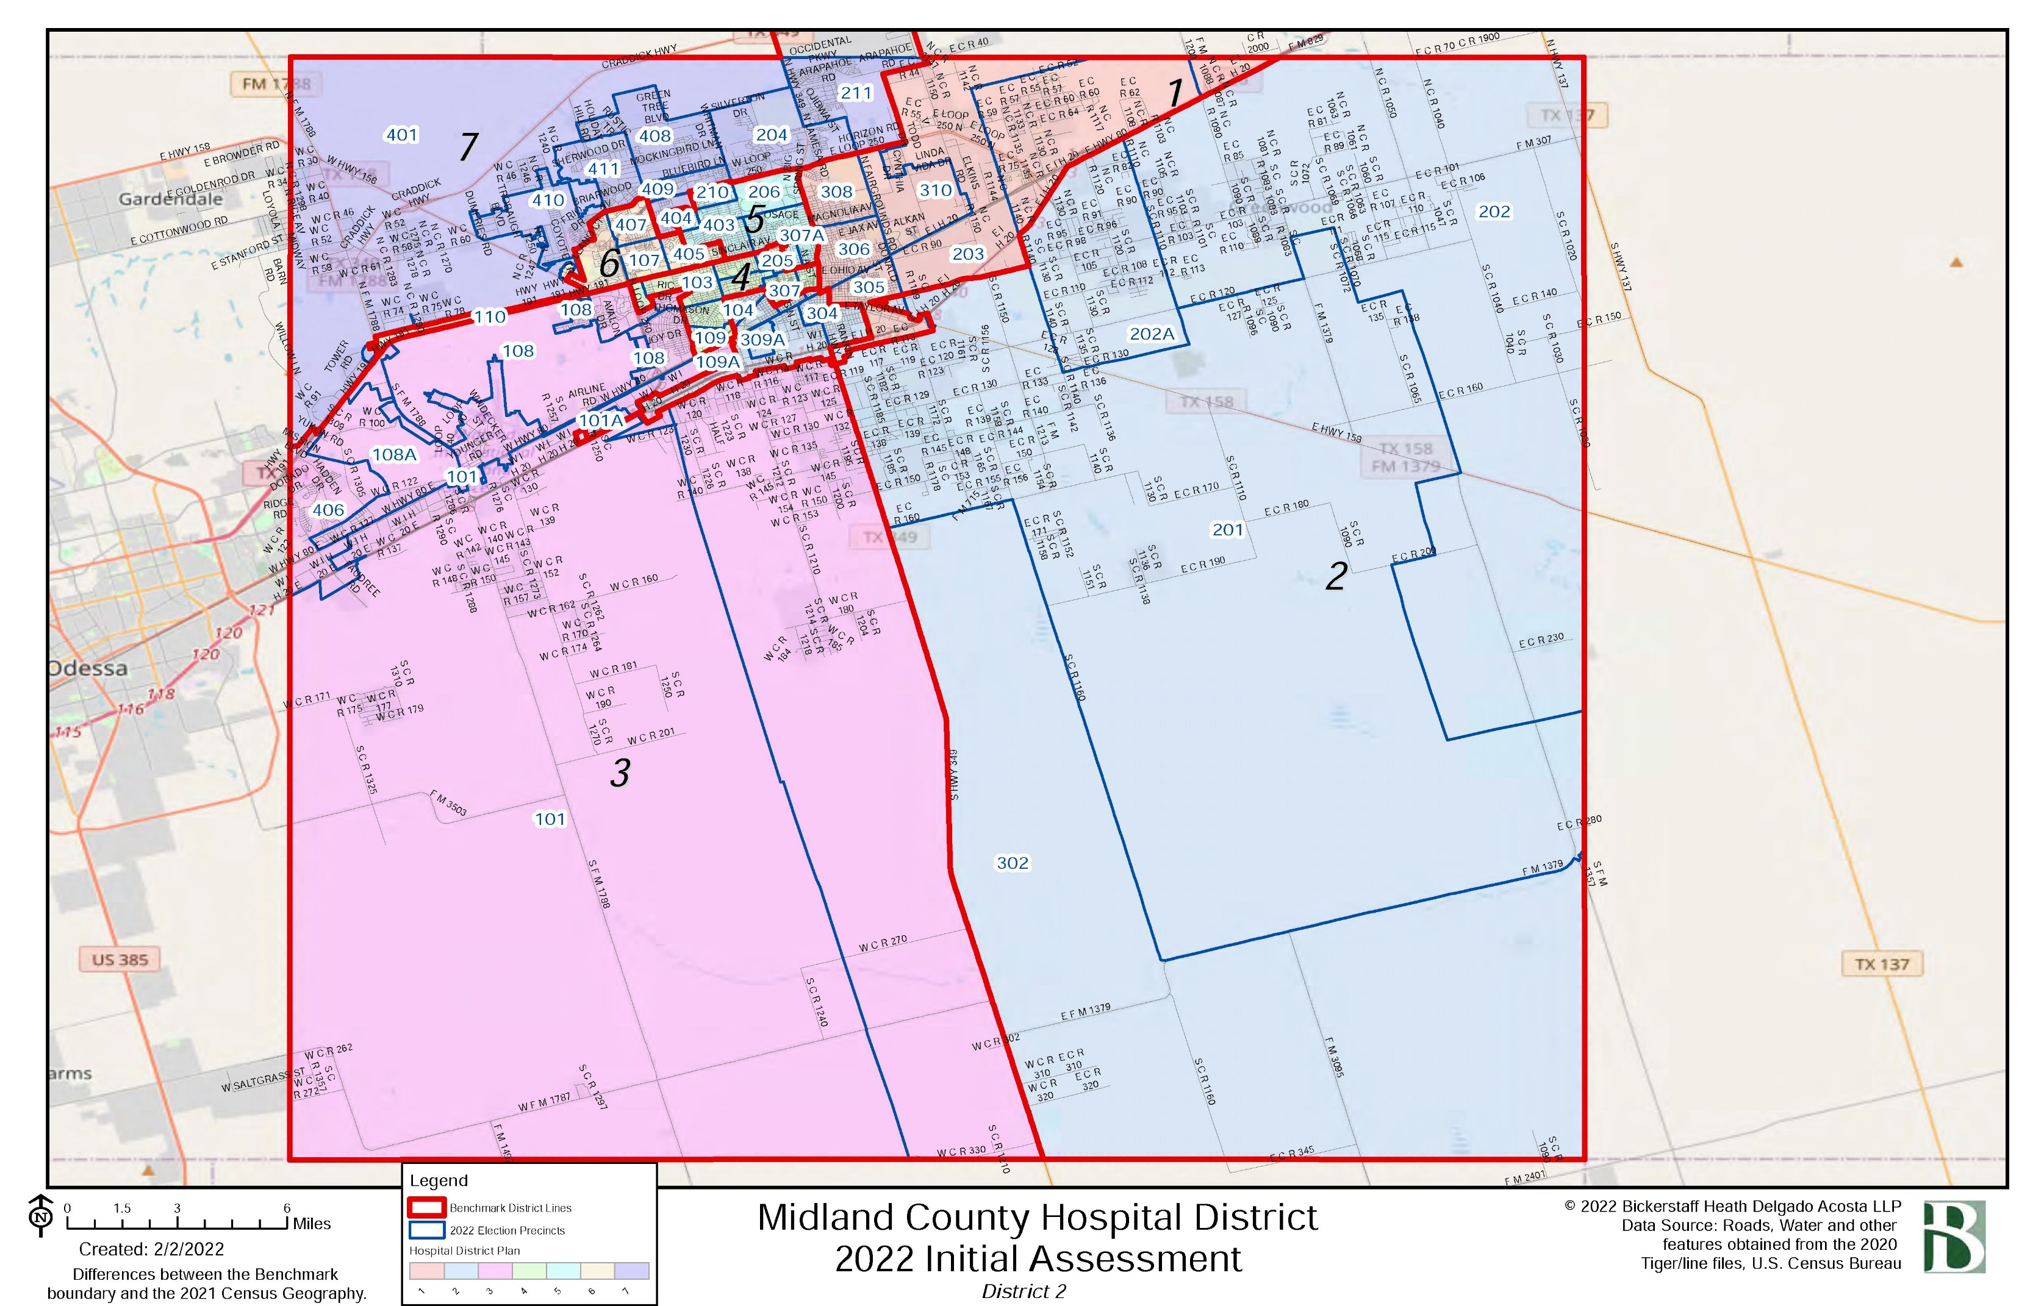
Individual District Maps

Slide 27
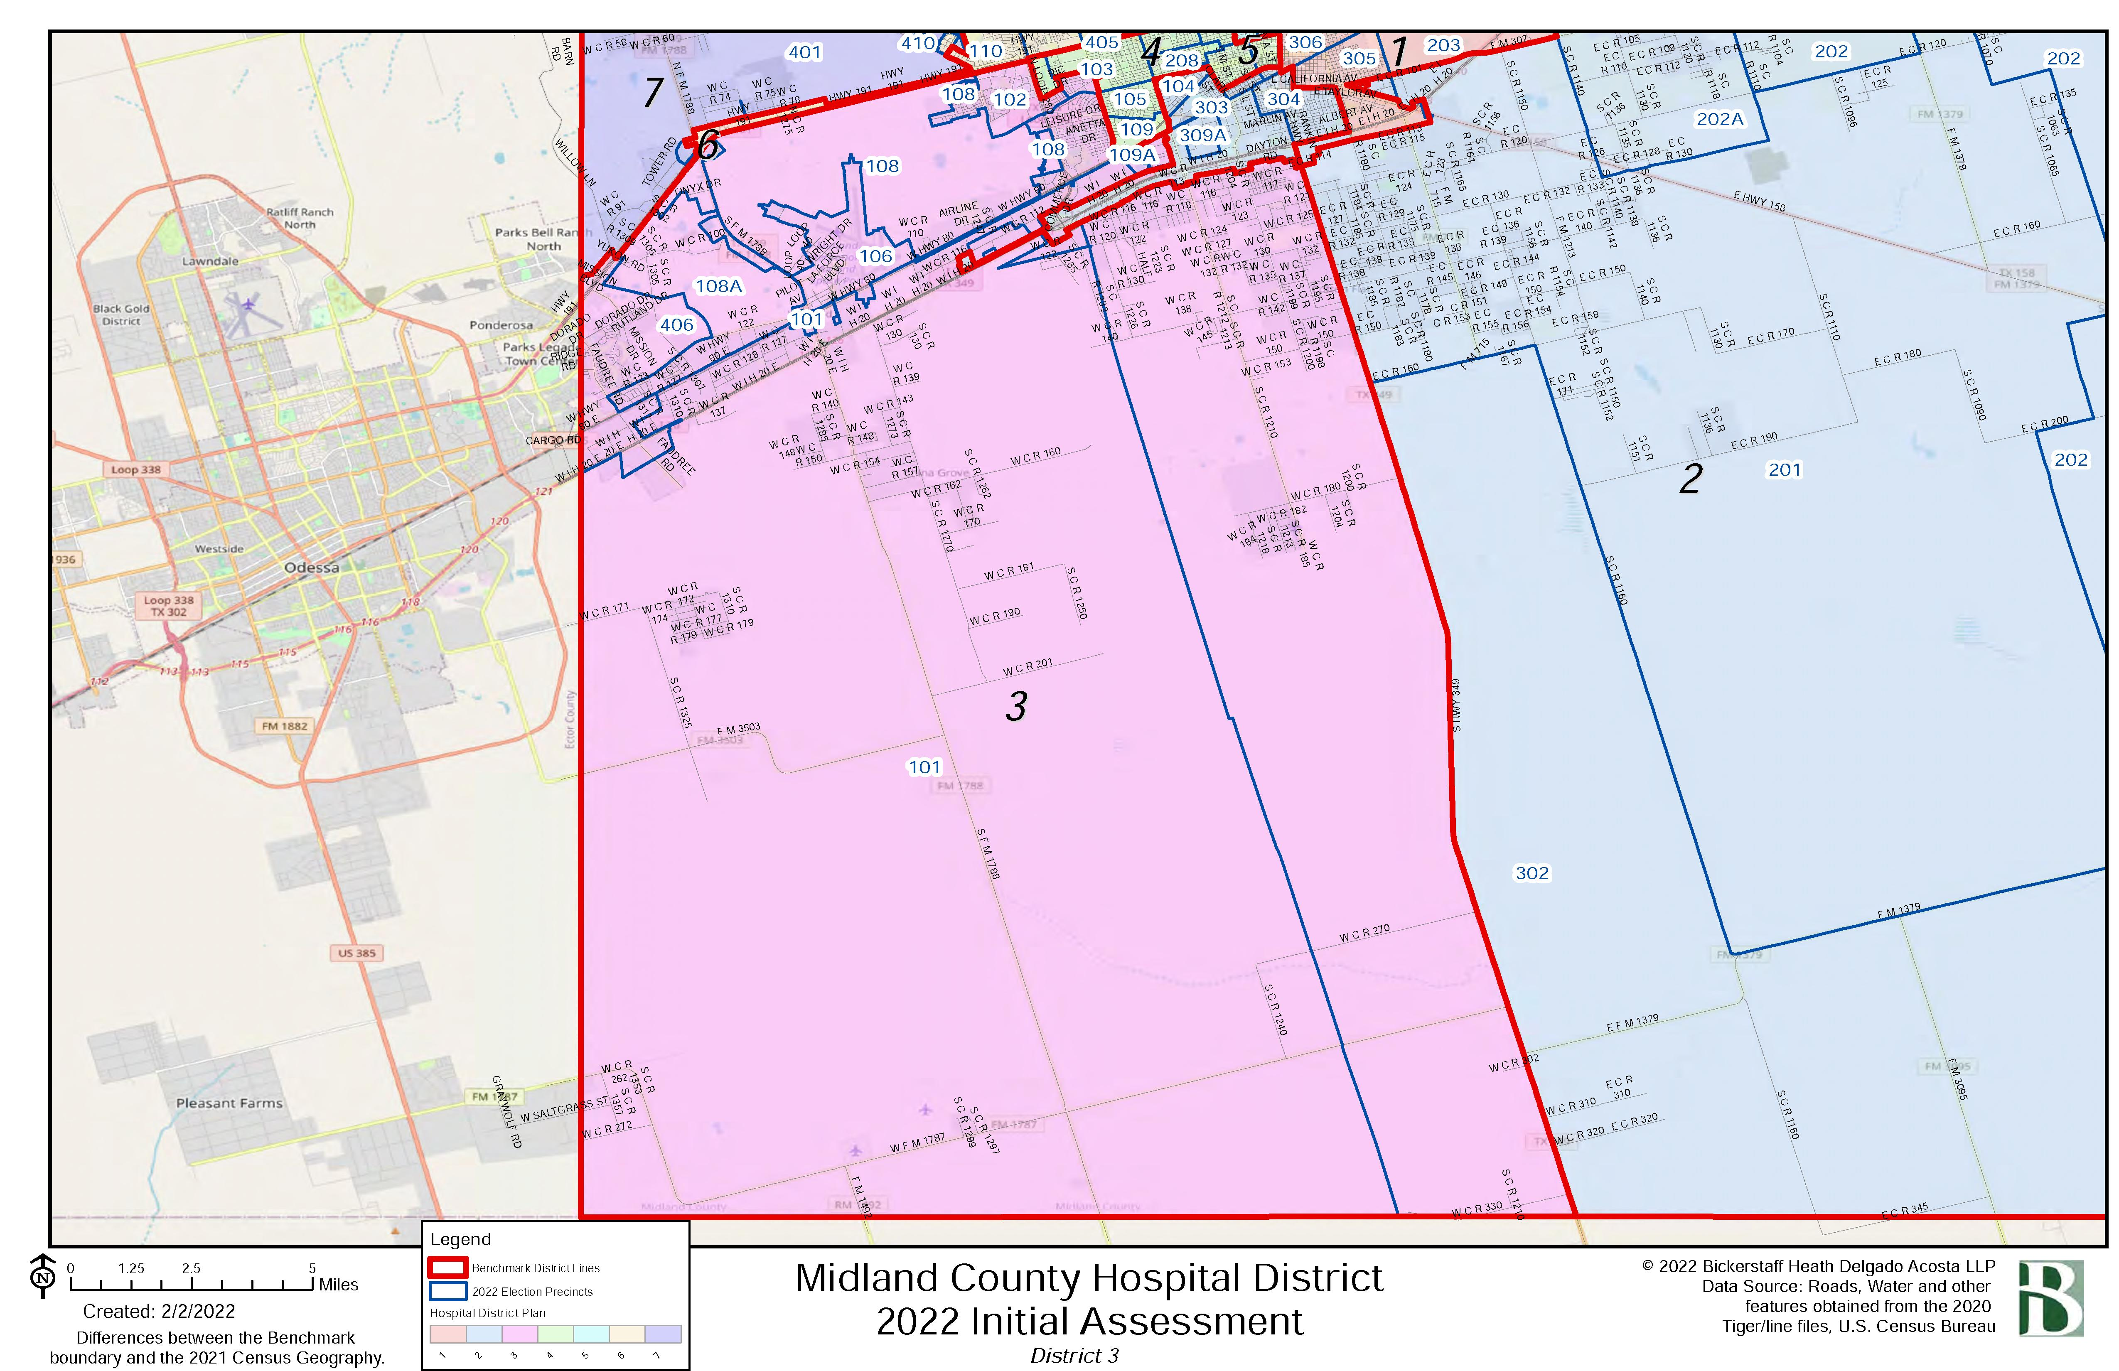
Individual District Maps

Slide 28
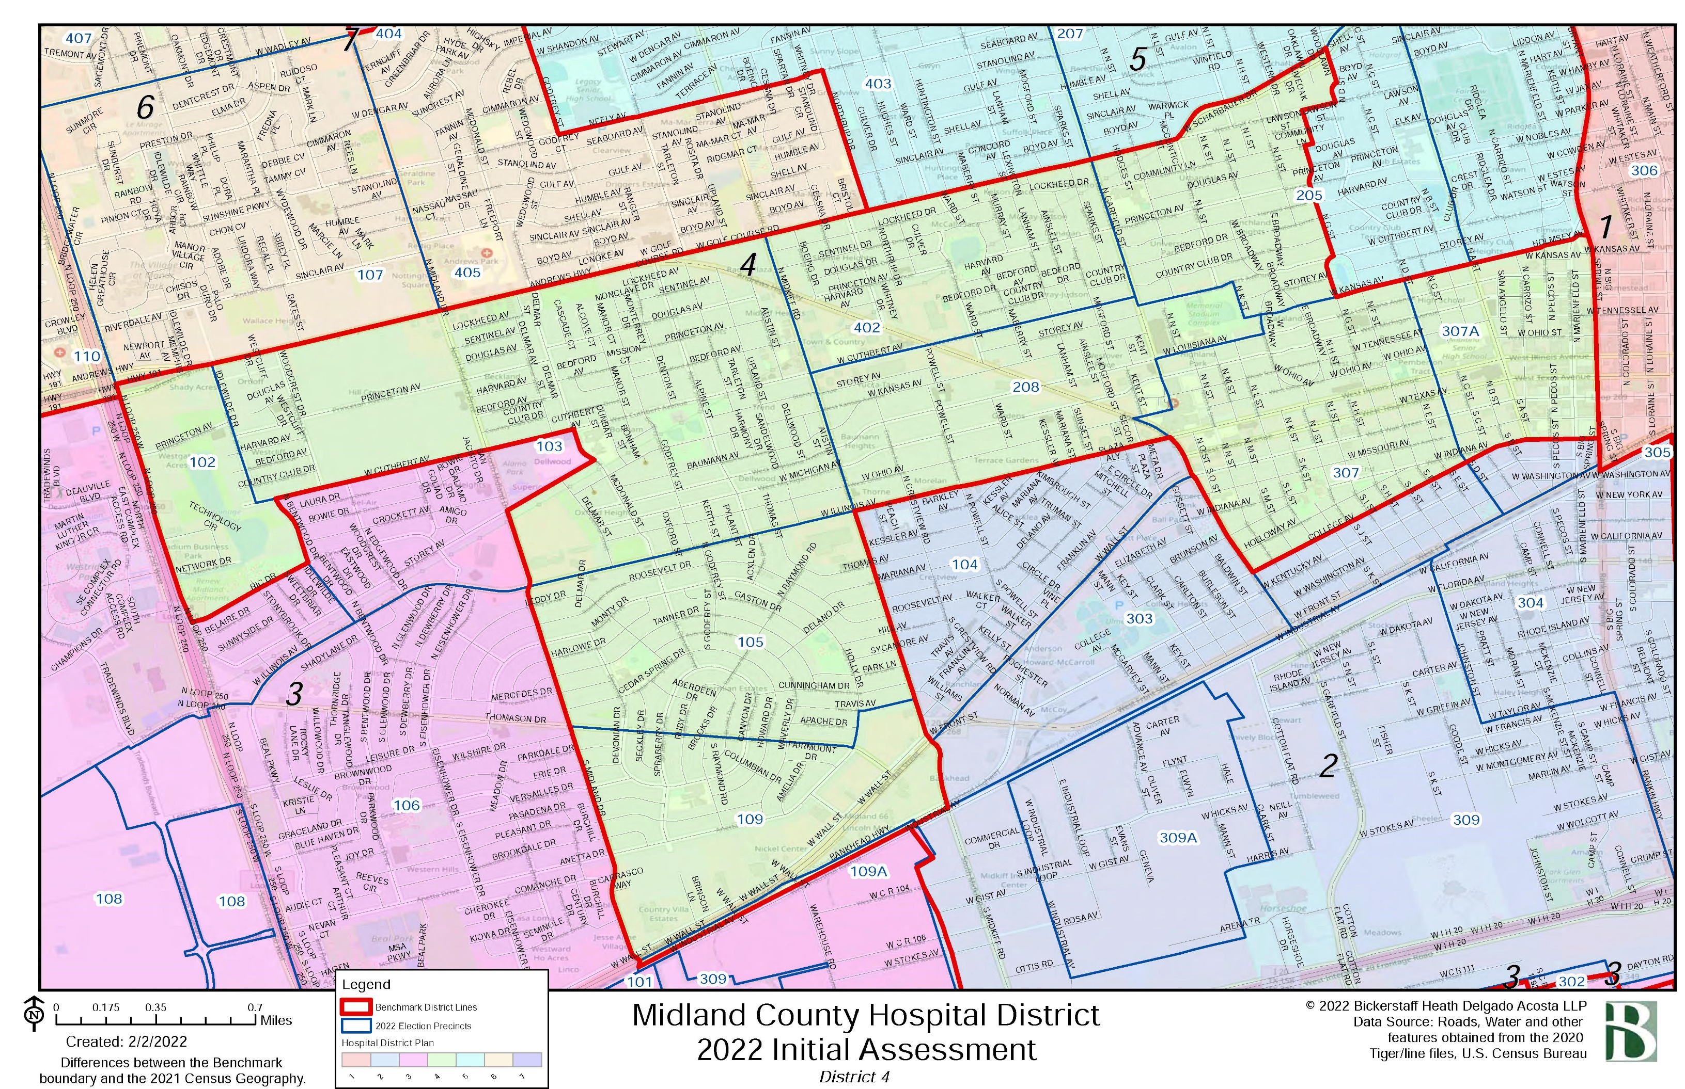
Individual District Maps

Slide 29
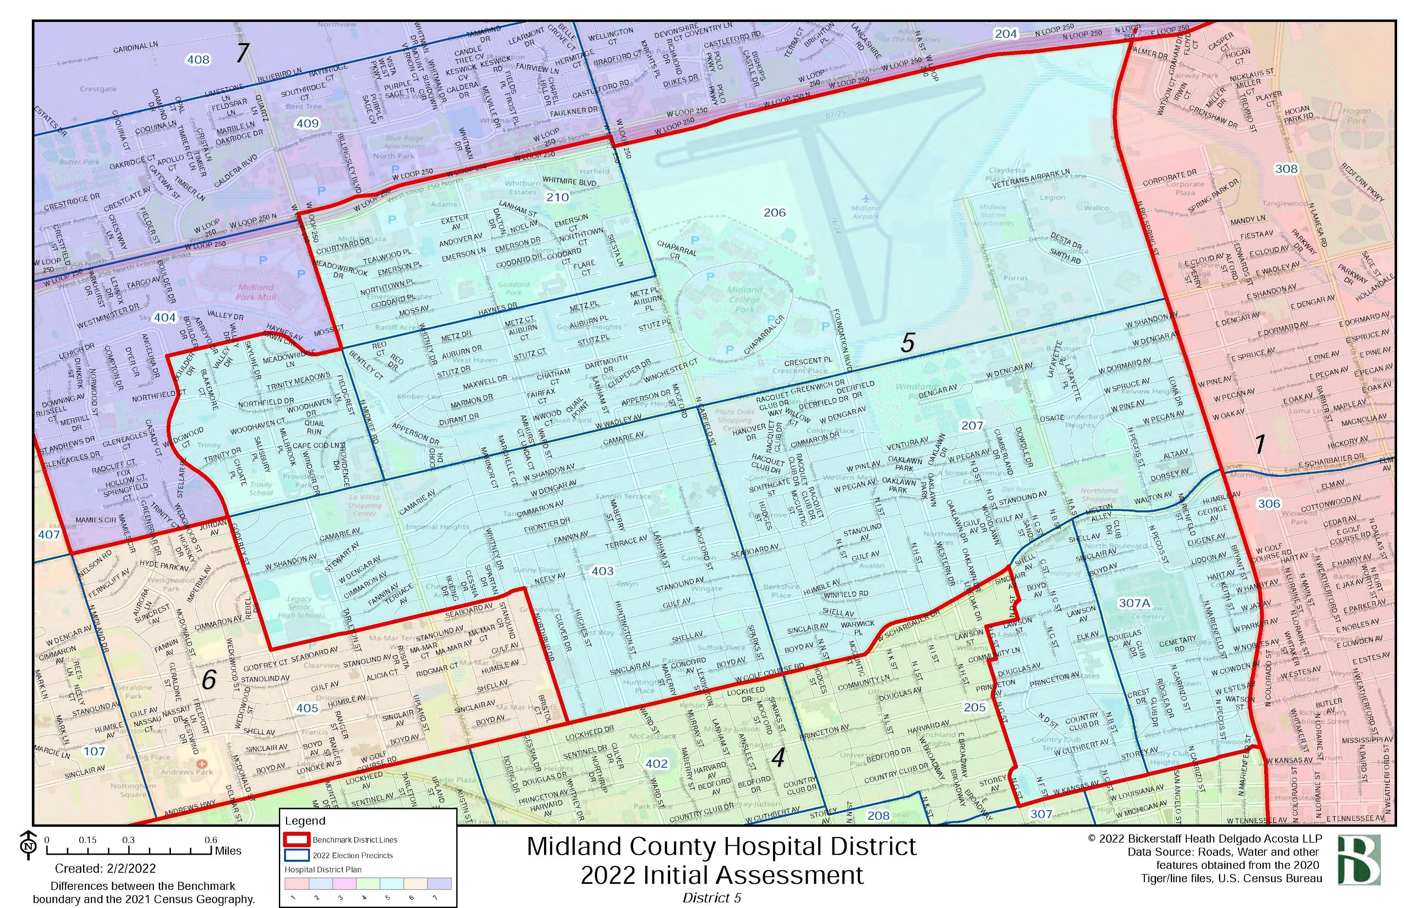
Individual District Maps

Slide 30
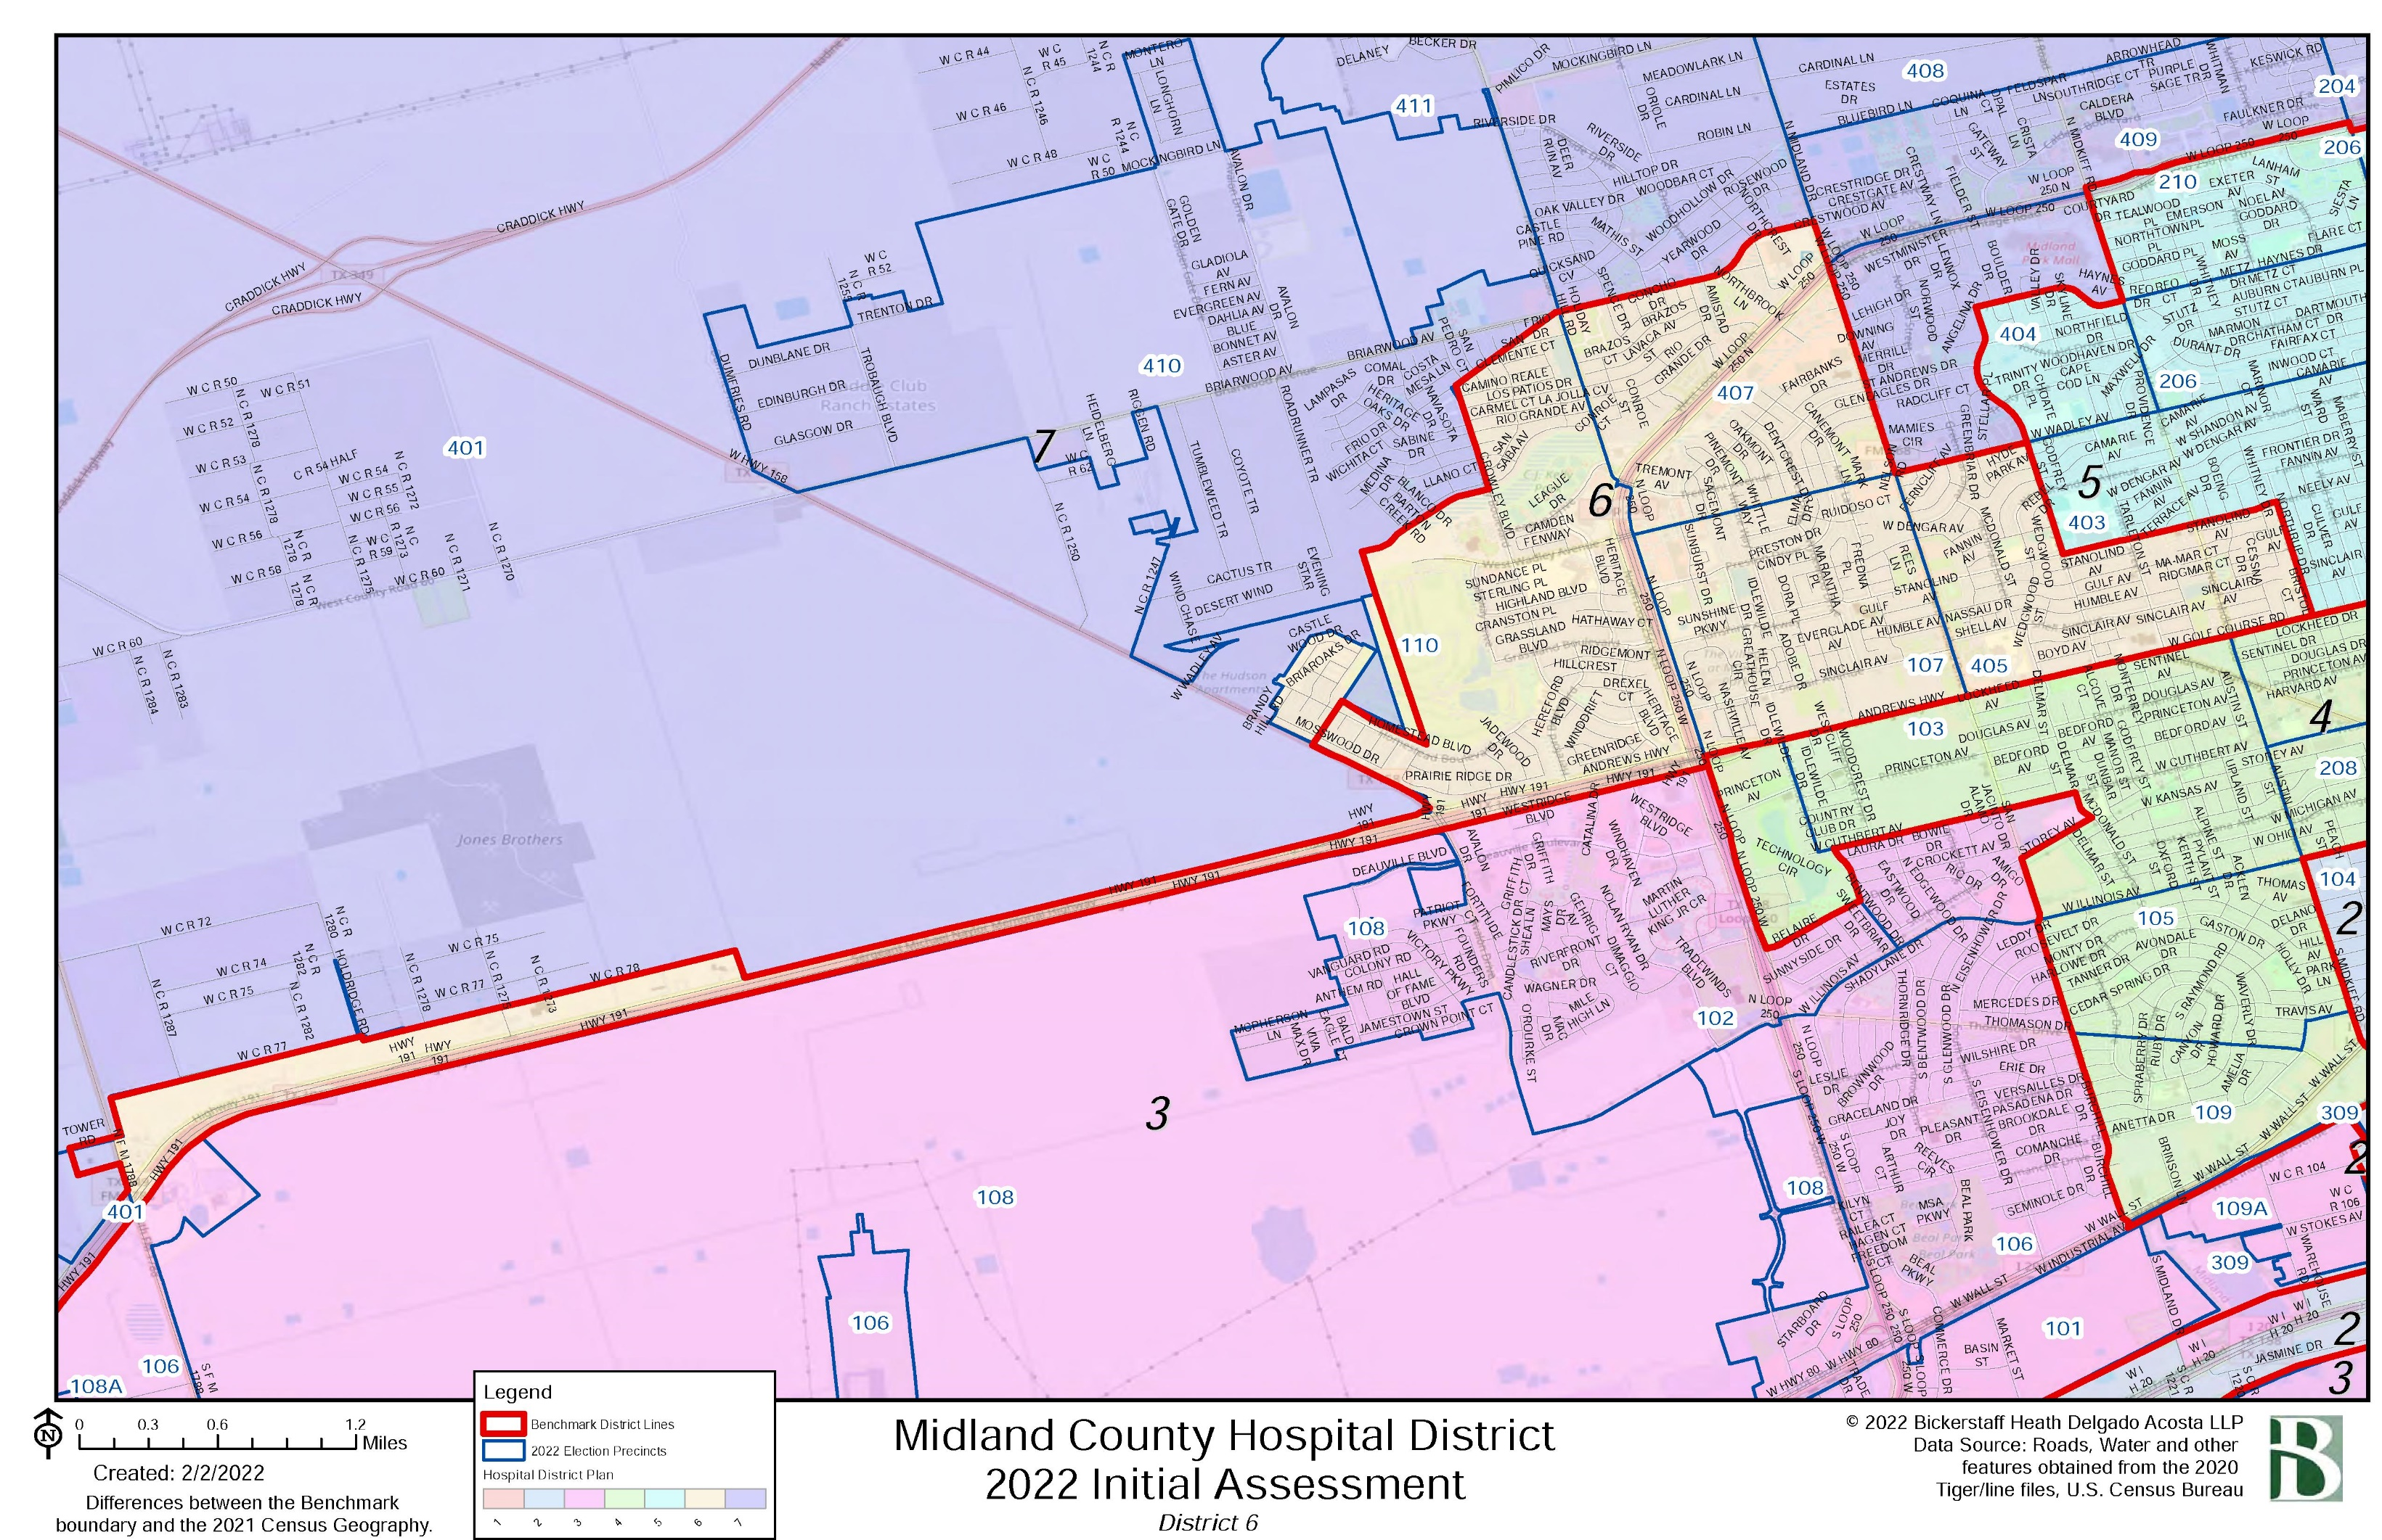
Individual District Maps

Slide 31
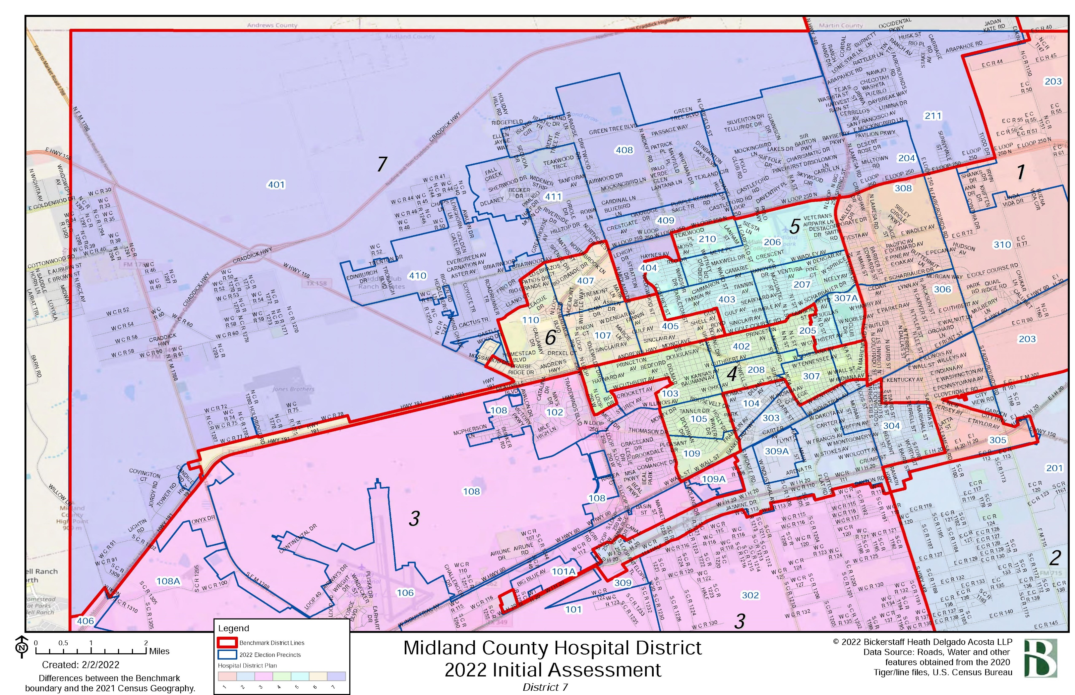
Individual District Maps

Slide 32
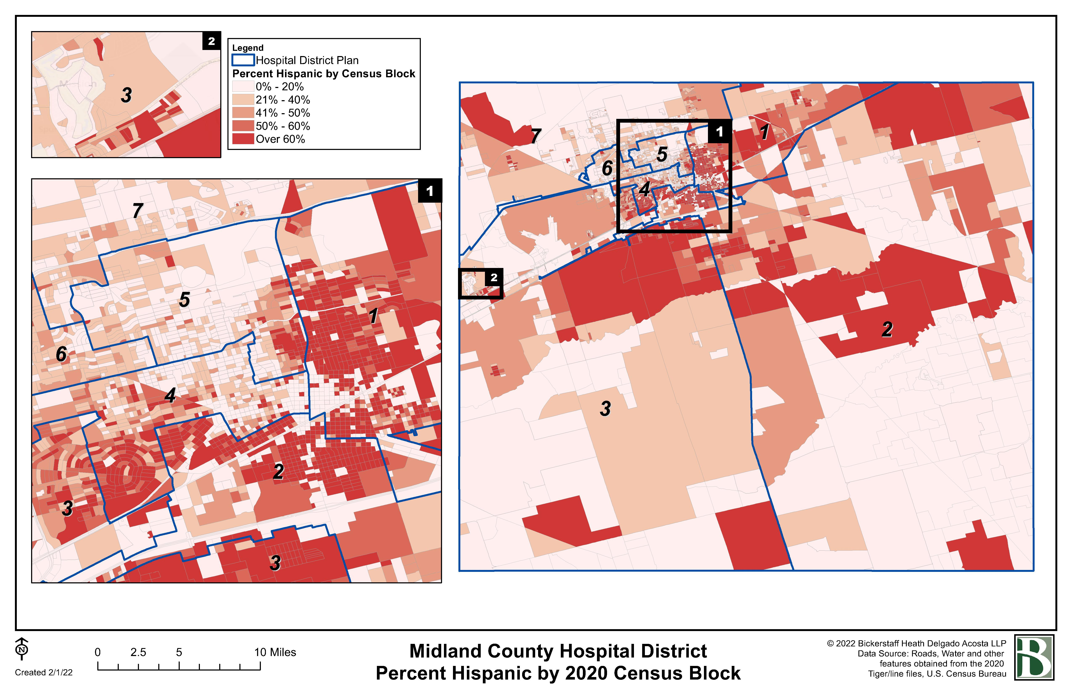
Thematic Maps

Slide 33
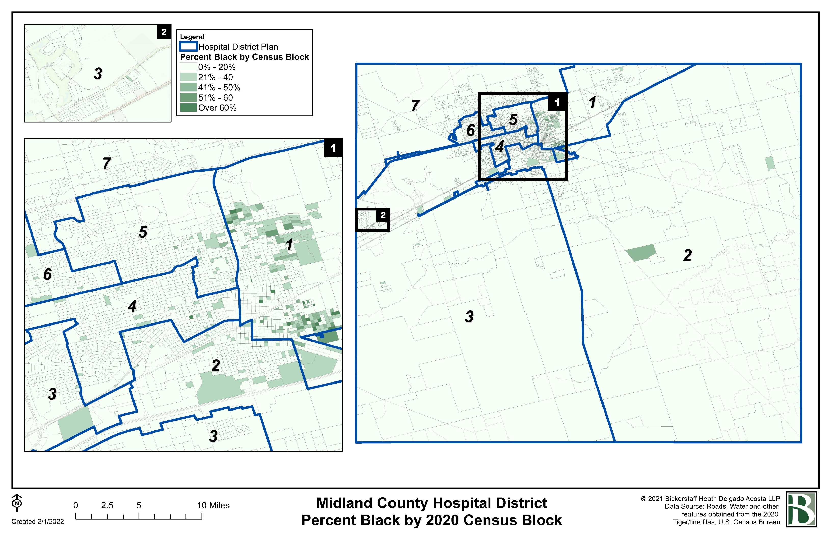
Thematic Maps

Slide 34

Questions
This Photo by Unknown Author is licensed under CC BY

Slide 35
Midland County Hospital District
2022 Redistricting
Initial
Assessment
BICKERSTAFF HEATH DELGADO ACOSTA LLP
3711 S. MoPac Expressway
Building One, Suite 300
Austin, Texas 78746
(512) 472-8021
www.bickerstaff.com
©2022
Notes:
Questions

